Slide 1
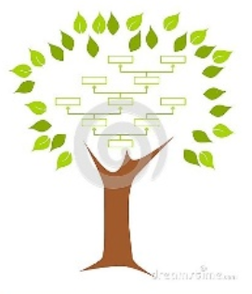
7-1. Decision tree (DT)
Youngsoo Kim <pineland@hanmail.net>
Code : https://github.com/pineland/AIDA/

Slide 2
Contents
What is the decision tree algorithm (DT)?
Issues with DT
Information gain (IG), Entropy
Building DT
Overfitting & Pruning
Advantages vs. Disadvantages of DT

Slide 3
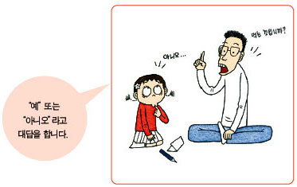
스무고개

Slide 4
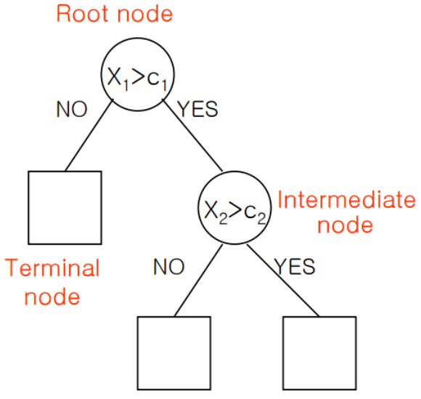
What is DT algorithm?
A tree in which each branch node represents a choice between a number of alternatives, and each leaf node represents a decision.
A type of supervised learning algorithm.
One of the most widely used and practical methods for Inductive Inference.

Slide 5
Problems appropriate for DT
Instances are represented by attribute-value pairs.
The target function has discrete output values.

Slide 6
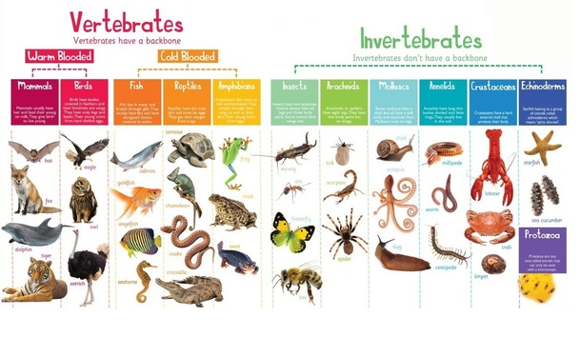
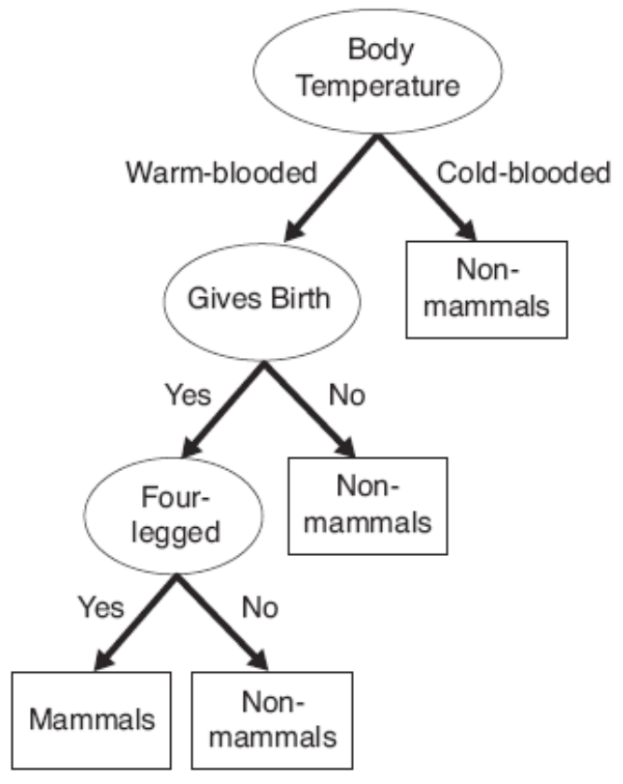
Example of DT(1): How to select mammals?

Slide 7
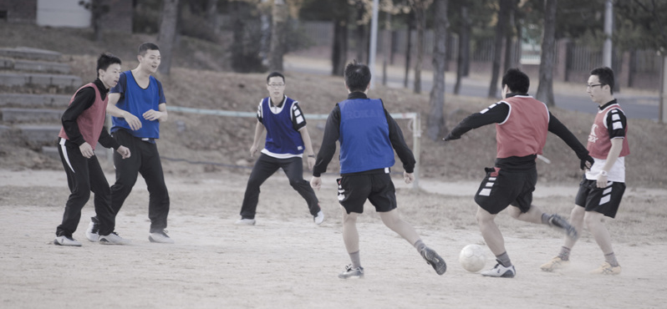
Example of DT(2): How to predict the result of a soccer game in the military?
Attributes
Stadium : Home / Away
Competition Time : 5 p.m. / 7 p.m. / 9 p.m.
Whether or not a player K in Team A will participate : Yes / No
Player S's Position in Team A : Striker / Midfielder
Whether or not a player R in Team B will participate : Yes / No
etc.
Let's make a model to predict whether team A will win or lose in the match between team A and team B next week.
Notes:
인공지능을_위한_머신러닝_알고리즘_4차시_결정트리 참조

Slide 8
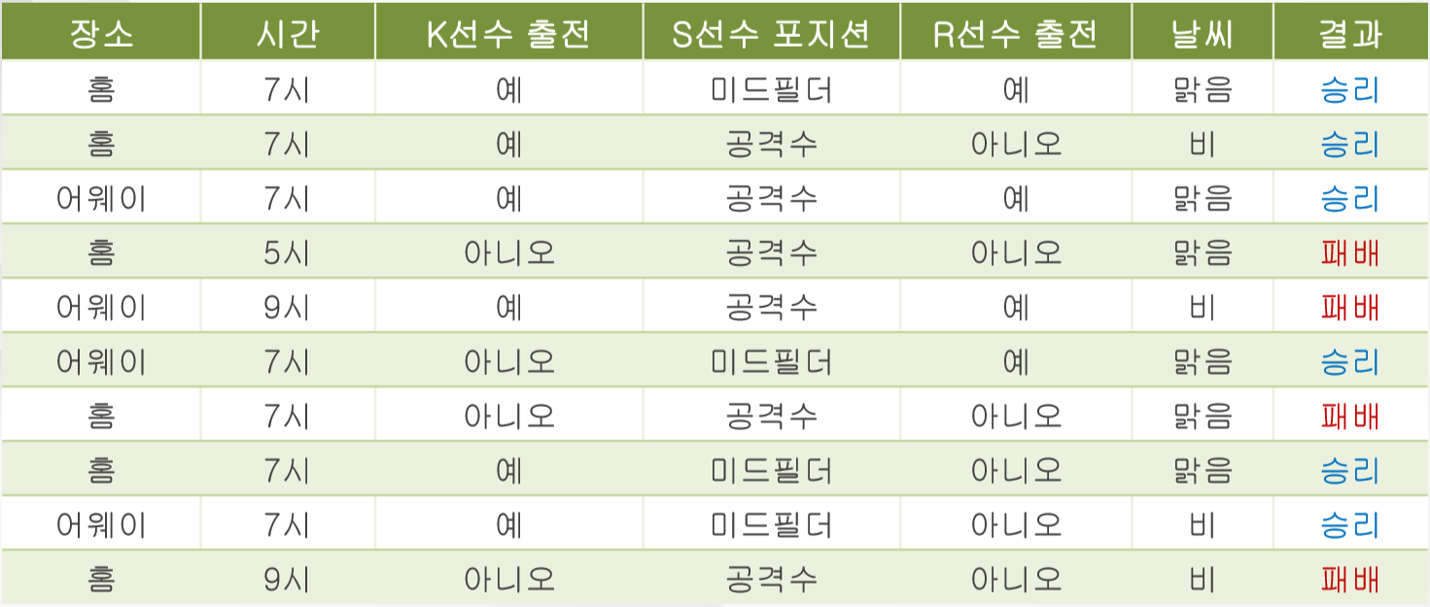
Dataset
New input

Slide 9
Issues of building DT
The DT starts at the root node, arrives at the appropriate terminal node according to the attributes’ values, and classifies the new data.
Issues ?
Which attribute do you start at? (root node)
What is the order of the intermediate nodes?
How many nodes do we have to make?

Slide 10
Attribute selection measures
In what order should the attributes be applied?
Choose an attribute first that produces “purer” nodes.
100% pure when all of its data belongs to a single class.
Make smaller (more efficient) tree.
3 popular attribute selection measures
Information gain
Gain ratio
Gini index

Slide 11
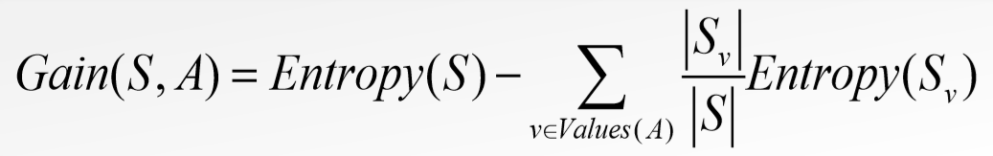
Information gain (IG)
Definition
The change in information entropy Η from a prior state to a state that takes some information as given:
Entropy(S) : Entropy of dataset S
Values(A) : a set of all possible values of attribute A.
S_{v} is a subset of S in the dataset S with which the value of attribute A is v.
The amount expected entropy of S when S is separated using attribute A.
The amount of expected entropy reduction when S is removed using attribute A.
|S| = number of elements in S

Slide 12
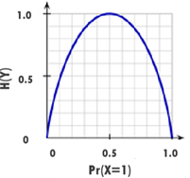
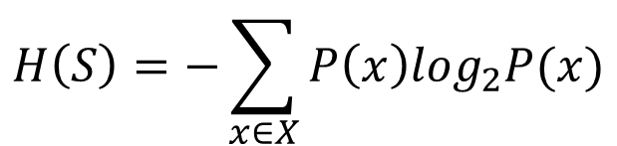
Entropy (H)
Uncertainty (disorder) of a prob. variable.
Highest Entropy(1) : the prob. of each output is even.
It has no information about the output.
Lowest Entropy(0) : the output is in a very solid state.
e.g.#1 Entropy when tossing a coin and the front and back are
the same.
∴ H(S) = -(1/2)log₂(1/2) - (1/2)log₂(1/2) = 1/2 + 1/2 = 1
e.g.#2 Entropy when you toss a coin, you have 1/4 chance of
getting the front and 3/4 of getting the back.
∴ H(S) = -(1/4)log₂(1/4) – (3/4)log₂(3/4) = 2/4+3/4×0.42 = 0.81
$$H\left(S\right)=−\sum_{x∈X}{P\left(x\right)\log_{2}P(x)}$$
* S : dataset, X : set of classes in S

Slide 13
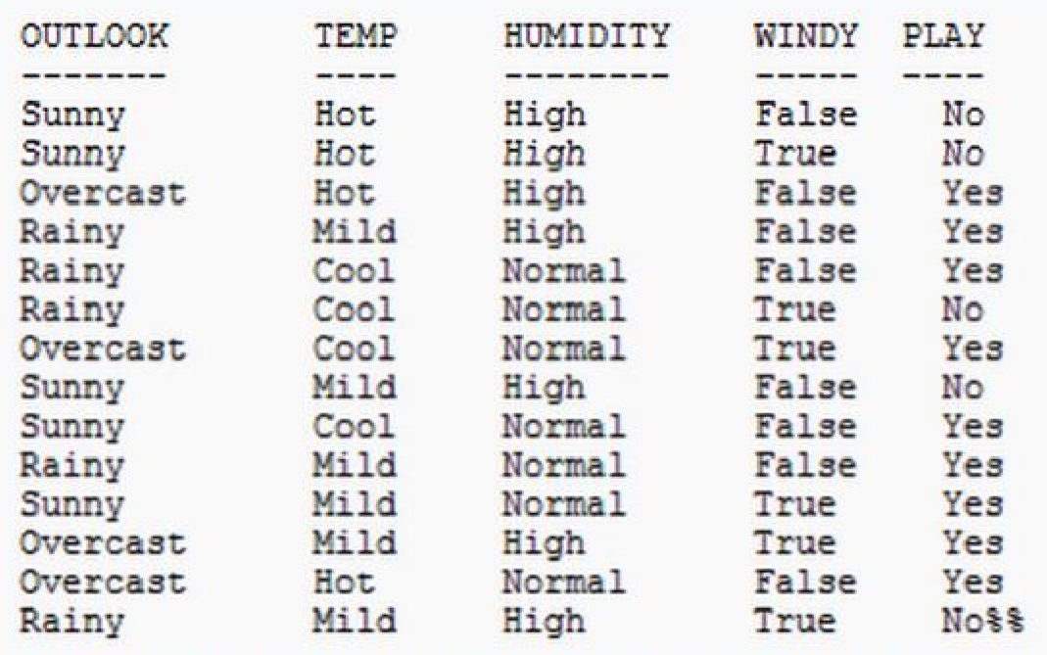
Building DT using IG
e.g. The weather dataset : play or not?

Slide 14
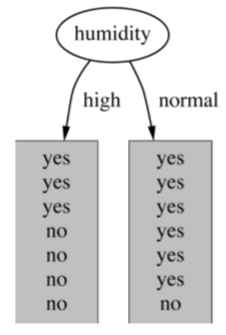
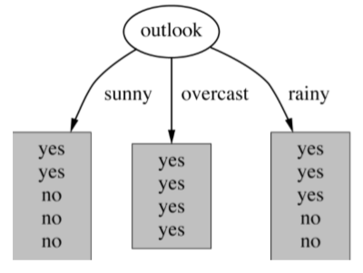
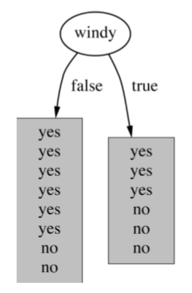
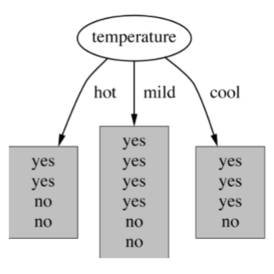
Which attribute to select?

Slide 15
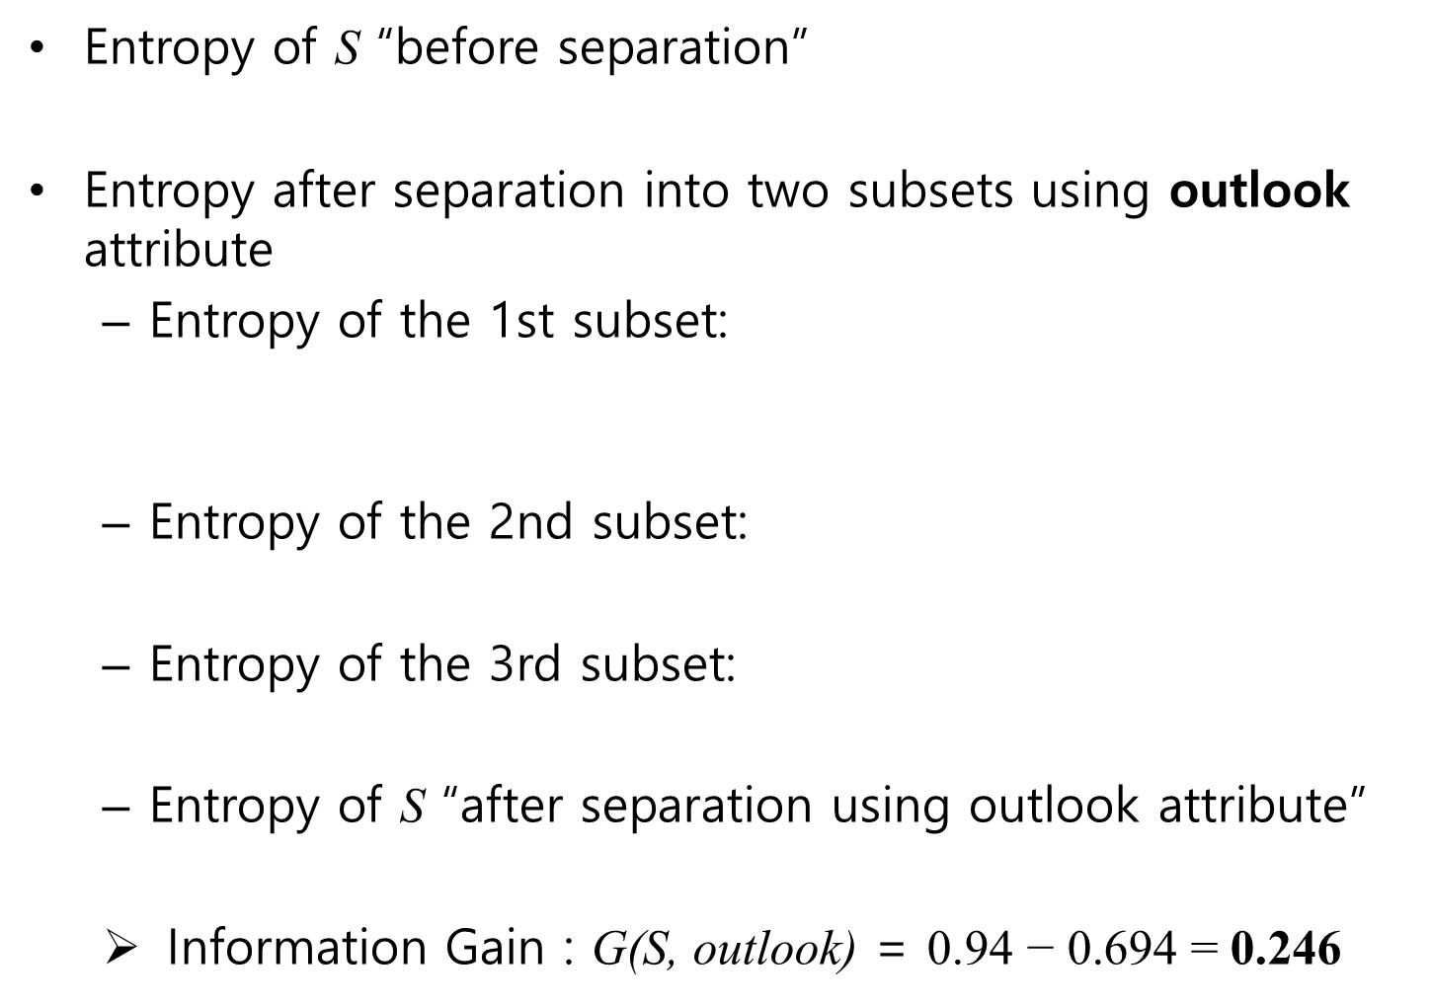

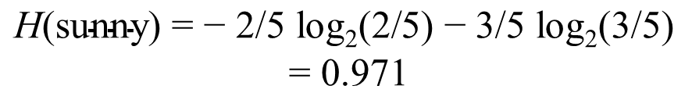
Entropy of S “before separation”
Entropy after separation into two subsets using outlook attribute
Entropy of the 1st subset:
Entropy of the 2nd subset:
Entropy of the 3rd subset:
Entropy of S “after separation using outlook attribute”
Information Gain : G(S, outlook) = $\text{0}\text{.9}\text{4 − 0.694 = }\text{0.246}$
$$\text{H}\text{(}\text{S}\text{)}\text{before}\text{ =} \text{H}\text{(}\text{9}\text{/}\text{14}\text{, }\text{5}\text{/}\text{14}\text{) = −}\text{9}\text{/}\text{14} \text{log}\text{2}\text{(}\text{9}\text{/}\text{14}\text{) −}\text{5}\text{/}\text{14} \text{log}\text{2}\text{(}\text{5}\text{/}\text{14}\text{) =} \text{0.}\text{94}$$
$$\text{H}\text{(}\text{sunny}\text{) = − }\text{2}\text{/}\text{5} \text{log}\text{2}\text{(}\text{2}\text{/}\text{5}\text{) − }\text{3}\text{/}\text{5} \text{log}\text{2}\text{(}\text{3}\text{/}\text{5}\text{)}$$
$$\text{ = }\text{0.971}$$
$$\text{H}\text{(}\text{o}\text{vercast}\text{) = − 4/4 }\text{log}\text{2}\text{(}\text{4}\text{/}\text{4}\text{) = }\text{0}$$
$$\text{H}\text{(}\text{rainny}\text{) = − }\text{3}\text{/}\text{5} \text{log}\text{2}\text{(}\text{3}\text{/}\text{5}\text{) − }\text{2}\text{/}\text{5} \text{log}\text{2}\text{(}\text{2}\text{/}\text{5}\text{) = }\text{0.971}$$
$$\text{H}\text{(}\text{S}\text{)}\text{after}\text{ = }\text{(5/14)}\text{ ∗ }\text{0}\text{.}\text{971}\text{ +}\text{(5/14)}\text{ ∗ }\text{0 +}\text{(5/14)}\text{ ∗ }\text{0.}\text{971} \text{= }\text{0.694}$$

Slide 16
Which attribute to select?
* G(S, outlook)
= 0.246
* G(S, humidity)
= 0.152
* G(S, windy)
= 0.048
* G(S, temperature)
= 0.029

Slide 17
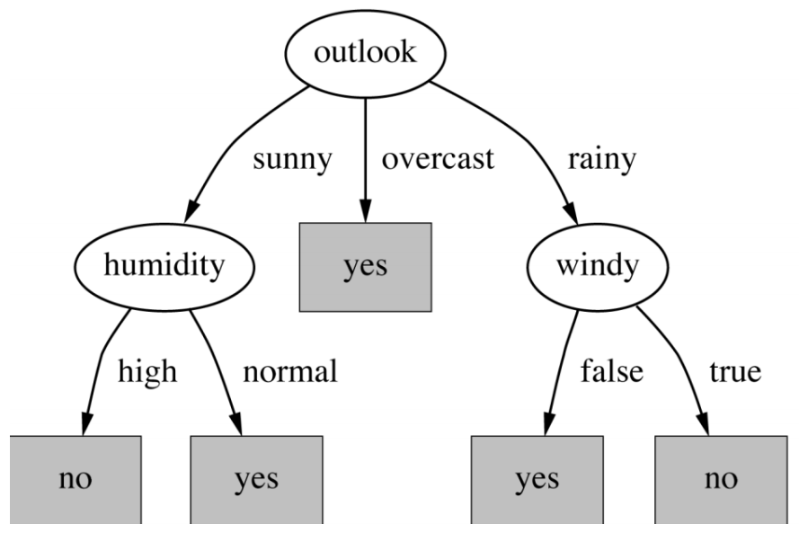
Final decision tree
⇒ Splitting stops when data can’t be split any further.

Slide 18
Building DT using IG
Strategy: top down
Recursive divide-and-conquer fashion
1. Select a attribute for root node using IG.
Create branch for each possible attribute value.
2. Split instances into subsets.
3. Repeat 1 and 2 for each branch until
different classes exist.

Slide 19
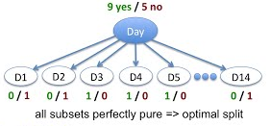
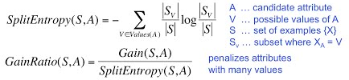
Problems of IG (1)
Biased towards attributes with many values (e.g. ID)
Won't work for new data
e.g. D15 Rain High Weak
Alternatives
Gain ratio
take the number and size of branches into account when choosing an attribute to reduce a bias towards many-valued attributes.

Slide 20


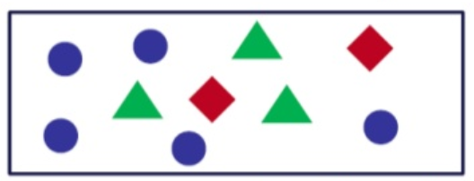
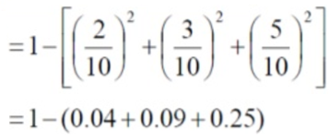
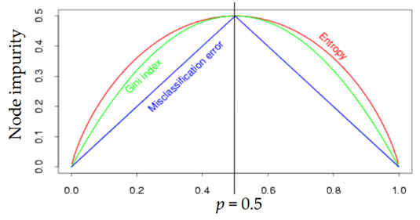
Gini index
A degree of inequality in a distribution.
i.e.)

Slide 21
Overfitting in DT
Causes of Overfitting
the tree is designed so excessively fit all samples in the training data set.
Lack of Representative Instances
Lack of representative instances in the training data can prevent refinement of the learning algorithm.
Approach to avoid overfitting
Pruning : Restrain trees from over-growing

Slide 22
Pruning of DT
Nodes are removed only when the resulting pruned tree performs no worse than the original over the validation set.
Pruning of nodes continues before further pruning is harmful (i.e., decreases the accuracy over the validation set).
Strategy
Post-pruning : take a fully-grown decision tree and discard unreliable parts.
Pre-pruning : stop growing a branch when information becomes unreliable.
Post-pruning preferred in practice
Pre-pruning can “stop too early”.

Slide 23
Sort of DTs
ID3
Uses information gain.
Handles only categorical values.
C4.5
Can use either information gain or gain ratio.
Can deal with numeric/continuous attributes and missing values.
CART (Classification and regression trees)
Similar to C4.5.
Supports numerical target variables. (regression)

Slide 24
Applications of DTs
Have been used for classification in many application areas
Medicine
Manufacturing and production
Financial analysis
Astronomy detection
Molecular biology
etc.

Slide 25
Advantages of DT
Accuracy is comparable to other classification techniques for many simple data sets.
Easily capture Non-linear patterns.
Requires fewer data preprocessing from the user.
i.e., there is no need to normalize columns.
Can be used for feature engineering such as predicting missing values, suitable for variable selection.
Ease to understand the rules of a model
Relatively faster than other classification methods (less calculated amount when classified).
Easily integrated with other classifiers.

Slide 26
Disadvantages of DT
Originally not suitable for data with continuous characteristic(numerical) values.
Poor performance when classes are many and data is insufficient.
Can be biased with imbalance dataset.
it is recommended that balance out the dataset before creating the decision tree.
Computational cost is high in the training course
In order to determine the order of node selection in the tree, all attributes must be calculated and sorted.

Slide 27

Q & A

